Slide 1
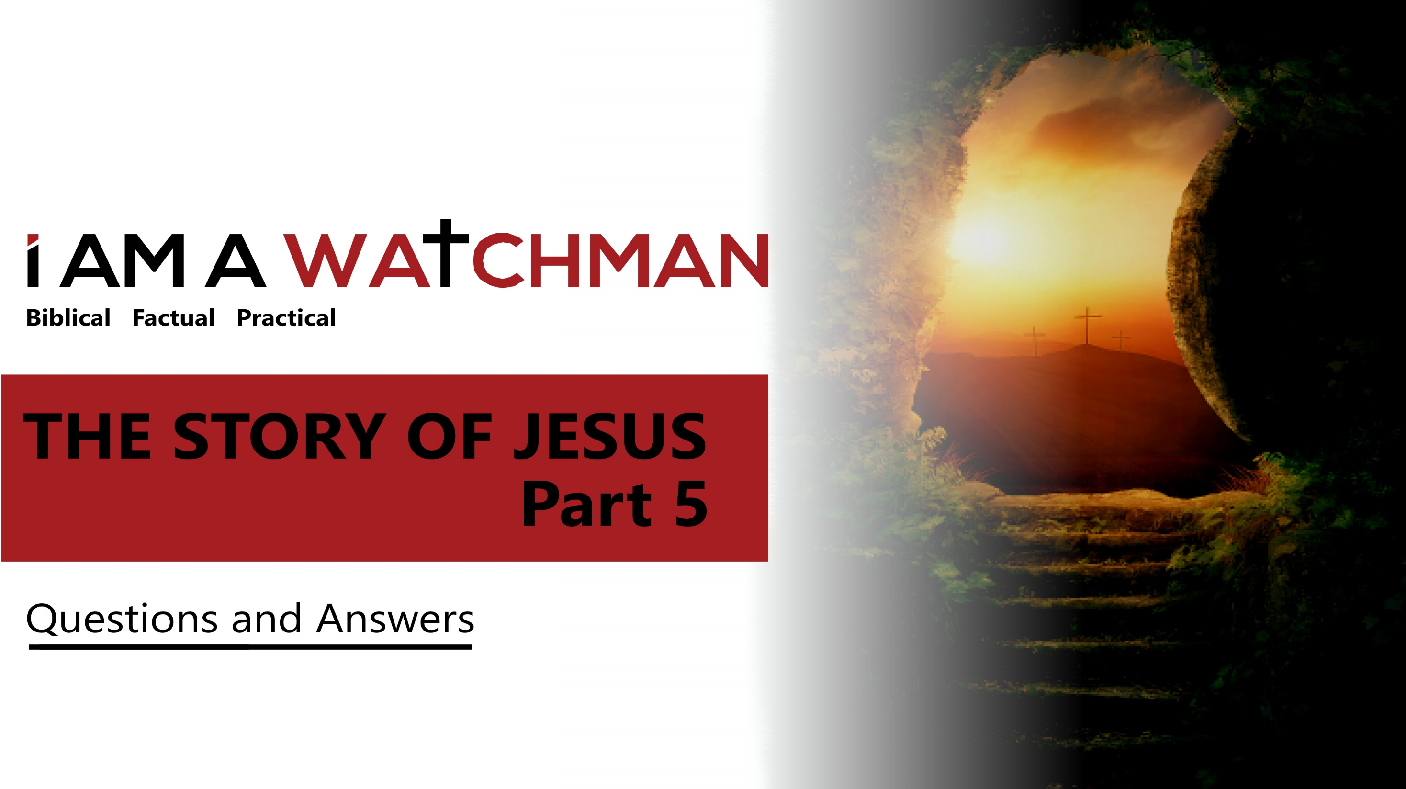

Slide 2
QUESTIONS AND ANSWERS
Q: Why did Jesus not observe all the traditions of the Pharisees?
At this time, the Pharisees had regulations regarding:
How to pray
When / how to fast
How and when to wash
Offerings, dress, diet, marriage
613 laws in all

Slide 3
QUESTIONS AND ANSWERS
Q: Why did Jesus not observe all the traditions of the Pharisees?
The Mishna (200 BC): An important commentary on the Law of Moses, but not to be understood as divinely given or inspired.
The Scripture: Inspired, helpful, God-breathed.
(2 Peter 1:20-21; 2 Tim. 3:16)
Notes:
The Mishna is a commentary on Old Testament Law (written about 200 BC). It was an important guiding document (similar to a nation’s Constitution). The regulations of the Pharisees primarily detailed how to live-out the Law (eg., The Law of Moses noted that the Sabbath Day is a day of rest. The regulation of the Pharisees stipulated that that meant one could not walk more than 1500 steps or tie a sandal with two hands on the Sabbath). The Law of Moses is different in that it does not express the wisdom or directives of religious leaders, but God.

Slide 4
QUESTIONS AND ANSWERS
Q: Why did Jesus not observe all the traditions of the Pharisees?
A: The Pharisees held that their interpretation of the Law, and regulations ostensibly in support of the Law, were equal in binding force to the Law.
“…These people honor me with their lips, but their hearts are far from me.” You have let go of the commands of God and are holding on to the traditions of men.” (Mark 7:7b,8)

Slide 5
QUESTIONS AND ANSWERS
An encounter with a Syrophoenician woman
The setting: This story takes place in the northern, heavily Gentile-impacted region of Israel. It was a region that came under the judgment God in centuries past (and was overrun by enemy armies). The Jewish religious leaders of the South looked down on the Jews in this region, and certainly avoided contact with Gentiles from this area. The fact that Jesus ministered in this area stands in stark contrast to the practice of first century AD Jewish religious leaders.

Slide 6
QUESTIONS AND ANSWERS
An encounter with a Syrophoenician woman
The request/response: The woman…begged Jesus to drive the demon out of her daughter. "First let the children eat all they want…for it is not right to take the children's bread and toss it to their dogs.” (Mark 7:26-27)
Her faith tested: Jesus’ rather strong response to was designed to see if her faith was strong or if she could be easily dissuaded. The term ‘dog’ was a cultural reference linked to the Gentile world. It marked the attitude of the Jews, not of Jesus.

Slide 7
QUESTIONS AND ANSWERS
An encounter with a Syrophoenician woman
The woman’s response and focus:
Respectful: “Yes Lord…but even the dogs under the table eat the children’s crumbs.” (v. 28)
Focus: Her focus was on what God was known to extend, not on what she felt she was entitled.
Notes:
The story is about the testing of faith, and how perseverance and belief in the power and goodness of Jesus lead to blessing.

Slide 8
QUESTIONS AND ANSWERS
Why did Jesus put His fingers in a man’s ears and spit and touch his tongue? (Mark 7:31-37)
The Gospels note Jesus’ amazing ability to communicate truth and love. To those who tended sheep, He spoke of being a “good shepherd.” To fishermen, He spoke of becoming “fishers of men.” To those in the desert, He spoke of “living water.” Here, to the man deaf and mute, he communicated via touch in a way both tender and understandable.

Slide 9
QUESTIONS AND ANSWERS
The term, “Ephphatha (Mark 7:31-37)
Ephphatha means, ‘be opened.’ It is one of the few words in the New Testament in Aramaic (likely the primary language of the man Jesus healed). The use of this word is another way to illustrate the exceptional tenderness, care and grace of Jesus.

Slide 10
THE FEEDING OF THE 4000
Similarities between the stories of the feeding of 4000 (Matt. 15:32-39) and 5000 (John 6)
The similarities are many. They include: thousands were listening to Jesus, there was no food, the disciples approached Jesus for help, the disciples suggested that Jesus send the crowd home, Jesus multiplied a few pieces of bread and fish and thousands ate, and there was food left over.

Slide 11
THE FEEDING OF THE 4000
Differences between the stories of the feeding of 4000 (Matt. 15:32-39) and 5000 (John 6)
The differences include: the number fed, the number of baskets of remaining food, the seating arrangement for the crowd during the meal, the amount of bread and fish presented at the beginning of the story, the location, the demographic profile (largely Gentile versus largely Hebrew), and what directly followed the miracle.
Notes:
Additional differences:
Bethsaida vs. the Decapolis
Multitude was local vs. Multitude had traveled far
Crowd was Jewish vs. Crowd was Gentile
Crowd was with Him 1 day vs. 3 days
Different kind of baskets used to collect excess
7 baskets vs. 12 baskets of excess

Slide 12
THE PHARISEES ASK FOR A SIGN
Prophetic verses such as Isaiah 35:4-6 and Isaiah 43:7-9 note that signs or miracles would accompany the Messiah’s ministry. Prophecies like these began to be voiced about 1450 years before the Messiah was born.
Matthew 16:1 notes the Pharisees’ intent: They were testing Jesus in an attempt to trap Him.
* πειράζω = pi-rad'-zo = entice/tempt

Slide 13
THE PHARISEES ASK FOR A SIGN
The reference to Jonah: “‘A wicked and adulterous generation looks for a miraculous sign, but none will be given it except the sign of Jonah.’ Jesus then left them and went away.” (Matt. 16:4)
The reference to Jonah points to: 1) the need for faith and repentance. The pagan Ninevites in Jonah’s day responded to the prophet’s call to believe and repent. This is a reproof as, in a sense, Jesus presents the faith of the Ninevites as superior to that of the Pharisees, and 2) the coming crucifixion, burial in the tomb, and resurrection of Jesus on the third day.

Slide 14
QUESTIONS AND ANSWERS
Why was the blind man in Bethsaida not healed immediately? (Mark 8:22-26)
The healing took place in stages
Note the unusual formula for healing (v. 23)
Jesus led him away from the crowd.
Jesus spit on the man’s eyes.
Jesus put His hands on him.
Jesus asked the man if he could see.

Slide 15
QUESTIONS AND ANSWERS
Why was the blind man in Bethsaida not healed immediately? (Mark 8:22-26)
In this story, we are not to see any limitation in Jesus’ power, but the importance of trusting God when His way or timing is unexpected.
Truth: God’s ways are wondrous and creative. We are to trust that the process He chooses to help, lead, bless, teach, and guide us is best.
Notes:
What this miracle reveals:
Unusual is not unacceptable
A process, can be viewed as God’s continuous good favor
Continued faith is the requisite to continued blessing

Slide 16
QUESTIONS AND ANSWERS
Why did some think Jesus was Jeremiah, John the Baptist, or Elijah? (Matthew 8:22-26)
John the Baptist was recently martyred.
Elijah was said to return (Malachi 4:4-5).
Jeremiah was called the Weeping Prophet—Isaiah referred to the Messiah as “The Man of sorrows,” and the circumstances of Jeremiah’s death were not known.

Slide 17
QUESTIONS AND ANSWERS
What is the most important question? (Matt. 16:15)
“Who do you say that I am?”
Peter said that “Jesus was the Christ, the Son of the Living God.”
Jesus said that Peter was “blessed,” and noted that he had spoken under the inspiration of the Spirit. Jesus also noted that the truth he spoke (that Jesus is the Christ) would serve as the Rock upon which the New Testament Church would be built.
Notes:
It was the TRUTH Peter spoke that Christ referred to, and not to Peter himself. The Church was built on the truth that Jesus Christ is the Messiah, the Son of God, THE Truth. Thus, this is the establishment of the Church, not the Catholic Church. Never make an entire doctrine from a single statement.

Slide 18
QUESTIONS AND ANSWERS
What is the most important question? (Matt. 16:15)
“Blessed art thou, Simon Barjona: for flesh and blood hath not revealed it unto thee, but my Father which is in heaven. And I say also unto thee, That thou art Peter, and upon this rock I will build my church; and the gates of hell shall not prevail against it.” Matthew 16:17-18 (KJV)
A play on words:
Peter = πέτρος (piece of rock)
Rock = πέτρα (a mass of/large rock)
Notes:
The word Peter in the original text indicates a small piece of rock. Peter is the small rock but the truth he spoke (that Jesus is the Christ), is the massive, strong, unmovable Rock (a related word in the original text) that would serve as the foundation for the coming New Covenant and New Testament Church.

Slide 19
QUESTIONS AND ANSWERS
What was the Transfiguration? (Luke 9:28-36)
It was a time to encourage Jesus and affirm His nature and calling.
It was a time when several of Jesus’ disciples witnessed the Lord in a glorified state—a wonder that would help them to believe in the possibility of a resurrection (important as soon, Jesus would be crucified).
The Transfiguration provided the disciples with a glimpse of Jesus’ divine nature.
Notes:
The Father affirmed the deity of Jesus, Moses (representing the Law) affirmed His deity, and Elijah (representing the Prophets) affirmed His deity.

Slide 20
QUESTIONS AND ANSWERS
Peter’s Suggestion (stay on the mountain)
Communing with God and having a “mountaintop experience” is wonderful, but never are believers to “stay on the mountain.” Believers are to share the blessings and good news they have received with others. Believers are commissioned to take the hope and joy of the Gospel to the ends of the earth.
(Matthew 28:18-20; Acts 1:7-8).

Slide 21
QUESTIONS AND ANSWERS
Why could the disciples expel demons in Mark 6, but not in Matthew 17?
Either the demon in Mark 17 had greater power than the demons the disciples encountered in Mark 6, or the disciples were not spiritually prepared to do what was needed in Matthew 17, or both.
Notes:
From this story, believers can infer the following: The enemy is powerful and active. He seeks to divide, discourage and destroy. Standing against the enemy can only be successful when believers 1) are sufficiently spiritually prepared to face him and 2) when believers act in the will of God and access divine power to accomplish the task.

Slide 22
JESUS AND THE TEMPLE TAX
What we are to know: Religious leaders were exempt from paying the Temple Tax.
Jesus’ directive to Peter was odd because: It seemed that 1) their situation was serious, and that it was not the time for fishing 2) a carpenter (Jesus) should not be advising a fisherman (Peter) how to fish (with a pole rather than a net), and 3) it was not the right time of day to go fishing.

Slide 23
JESUS AND THE TEMPLE TAX
What we are to learn:
1) God can meet the need.
2) God always has a plan.
3) God’s plan and directives will often seem strange.
4) Following God’s plan and directives leads to receiving God’s blessings.

Slide 24
Story
THE
Jesus
of

