Slide 1
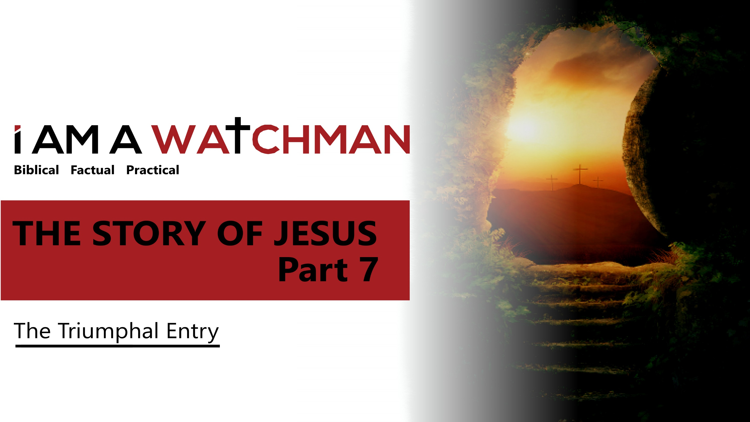

Slide 2
THE TRIUMPHAL ENTRY
From Matthew 21
“As they approached Jerusalem and came to Bethphage on the Mount of Olives, Jesus sent two disciples, saying to them, "Go to the village ahead of you, and at once you will find a donkey tied there, with her colt by her. Untie them and bring them to Me. If anyone says anything to you, tell him that the Lord needs them, and he will send them right away.” This took place to fulfill what was spoken through the prophet:

Slide 3
THE TRIUMPHAL ENTRY
From Matthew 21
"Say to the Daughter of Zion, ‘See, your king comes to you, gentle and riding on a donkey, on a colt, the foal of a donkey.’ The disciples went and did as Jesus had instructed them. They brought the donkey and the colt, placed their cloaks on them, and Jesus sat on them. A very large crowd spread their cloaks on the road, while others cut branches from the trees and spread them on the road. The crowds that went ahead of Him and those that followed shouted, ‘Hosanna to the Son of David!’"
Notes:
Continued on next slide

Slide 4
THE TRIUMPHAL ENTRY
From Matthew 21
“’Blessed is he who comes in the name of the Lord! "Hosanna in the highest!’ When Jesus entered Jerusalem, the whole city was stirred and asked, ‘Who is this?’ The crowds answered, ‘This is Jesus, the prophet from Nazareth in Galilee. The blind and the lame came to Him… and He healed them.’ But when the…priests…saw the wonderful things He did and the children shouting in the temple area, ‘Hosanna to the Son of David,’ they were indignant…”
Notes:
Continued on next slide

Slide 5
THE TRIUMPHAL ENTRY
From Matthew 21
“’Do you hear what these children are saying?’ they asked... ‘Yes,’ replied Jesus, ‘have you never read, 'From the lips of children and infants you have ordained praise'?"

Slide 6
THE TRIUMPHAL ENTRY
One of the few stories in all four Gospels
John 12:12-10
Matt. 21:1-17
Mark 1:1-11
Luke 19:29-40

Slide 7
THE TRIUMPHAL ENTRY
This event announces the culmination of God’s plan of the ages
“I will send them a prophet… from among their own people; I will tell him what to say, and he will tell the people everything I command.” (Deuteronomy 18:18)
“This is the prophet Jesus, from Nazareth in Galilee.” (Matthew 21:11)

Slide 8
THE TRIUMPHAL ENTRY
From Luke 19
“⁴¹And when he drew near …the city, he wept over it, ⁴² saying, “Would that you…had known on this day the things that make for peace! …⁴³For the days will come…when your enemies will…surround you…And they will not leave one stone upon another in you, because you did not know the time of your visitation.”
Notes:
The chorus, “This is the day (this is the day), that the Lord has made (that the Lord has made)…is an adaptation of part of the Great Hallel—the spngs/ Psalms that were sung by all Hebrews during the Passover season. That ancient Psalm references the day of the Triumphal Entry.

Slide 9
THE TRIUMPHAL ENTRY
From Daniel 9
“²⁵…Know and discern that from the issuing of a decree to restore and rebuild Jerusalem until Messiah… there will be seven weeks and sixty-two weeks… ²⁶Then …the Messiah will be cut off…and the people …will destroy the city and the sanctuary…there will be war; desolations are determined.”
March 14th, 445 BC
Notes:
The day of the Triumphal Entry is the fulfillment of the Daniel 9 prophecy.
King Artaxerxes I of Persia issued the commandment to specifically rebuild Jerusalem and its wall (see Nehemiah 2:2-9 ... the book of Nehemiah records this account of rebuilding the city and its wall.).
This commandment to rebuild starts Daniel’s 69 week prophetic timeclock.

Slide 10
THE TRIUMPHAL ENTRY
From Daniel 9
^{“25} …Know and discern that from the issuing of a decree to restore and rebuild Jerusalem until Messiah… there will be seven weeks and sixty-two weeks…”
7 + 62 = 69 (weeks of years)
483 years = 173,880 days
Add 173,880 days to the date of the decree (March 14th, 445 BC)
Adjust for the year “zero"
You arrive at the day of the Triumphal entry

Slide 11
WHAT WE ARE TO SEE
1. Jesus came to us
"As Jesus and his disciples approached Jerusalem…” (Matthew 21:1a)
It was 19 miles from Jericho to Jerusalem.
“For I have come down from heaven not to do my will but to do the will of him who sent Me.” (John 6:38)
- It was not an easy or comfortable plan. (Phil. 2:5-10)
It was not a plan we (humanity) initiated. (Romans 5:8)
It was and is a plan to benefit all. (John 3:16)

Slide 12
WHAT WE ARE TO SEE
2. Jesus sends and commissions us
"As Jesus and His disciples approached Jerusalem…Jesus sent two of the disciples on ahead with…instructions…” (Matthew 21:1b)
SENT = Apo-stéllō in the original text (from apó, "away from" and stéllō, "send")
Apo-stéllō: Is an intensification of stéllō. It strongly links back to the source (the One who sends)
Notes:
Jesus told them where to Go
He told them when to go
He told the WHAT they’d see
He told them what to DO
He told them what to SAY

Slide 13
WHAT WE ARE TO SEE
3. Jesus is the fulfillment of prophecy
Matthew 21:1 is the fulfillment of the Dan. 9:27 prophecy.
Matthew 21:2 is the fulfillment of the Zech. 9:9 prophecy.
“Go to the village…[and] you will find a donkey tied up with her colt beside her. Untie them and bring them to me.” (Matthew 21:2)
“Rejoice greatly…shout…Jerusalem! See, your king comes to you, righteous and victorious, lowly and riding on a donkey, on a colt, the foal of a donkey.” (Zechariah. 9:9)

Slide 14
WHAT WE ARE TO SEE
3. Jesus is the fulfillment of prophecy
Psalm 118:24 prophetically references ‘the day’
Psalm 118:25-26 notes what the people would cry out: “Lord Save us [Hosanna]….Blessed is He who comes in the name of the Lord.”
His identification as “the prophet” (Matt. 21:11) links to the Isaiah 9:1-2 prophecy.
Notes:
(V.11) The Palm Branches
Fulfills the traditions associated with the Feast of Booths/ Tabernacles/Sukkot - Leviticus 23
…Continued on next slide

Slide 15
WHAT WE ARE TO SEE
3. Jesus is the fulfillment of prophecy
Jesus’ reference to ‘My house’ (V.12) is linked to the prophetic statement in Isaiah 56:7.
Jesus’ entry into the Temple (Matt. 21:12) is the fulfillment of the Malachi 3:1 prophecy.
Notes:
Isa. 56:7 my house will be called a house of prayer for all nations.”
VV. 15-16 notes the children singing praises.
Mal. 3:1 notes that: “I will send my messenger, who will prepare the way before me. Then suddenly the Lord you are seeking will come to his temple…

Slide 16
WHAT WE ARE TO SEE
4. Jesus is worthy of praise
The owner of the donkey deferred to Jesus.
The unbroken colt yielded to Jesus.
The money changers took orders from Jesus.
Temple officials tried but could not intimidate/stop Jesus
The crowds praised Jesus (over the protests of the Pharisees) and threw down their cloaks before Him.
Children praised Jesus.

Slide 17
WHAT WE ARE TO SEE
5. Jesus makes us worthy
Jesus healed and made the ‘unworthy’ physically clean.
“…The blind and the crippled came to Him in the Temple, and He healed them. The chief priests and the teachers of the Law became angry when they saw the wonderful things He was doing…” (Matthew 21:13-15)
“…The days are coming,” declares the Lord, “when I will make a new covenant with the people of Israel…I will forgive their wickedness and will remember their sins no more.” (Jeremiah 31:31-34)
Notes:
"The days are coming, says the Lord, when I will draw up a new covenant with the people…I will be their God, and they will be my people...I will forgive their sins and will no longer remember their wrongs.“ Heb. 8:8b-12

Slide 18
WHAT WE ARE TO SEE
Our future
“After this I looked, and there was an enormous crowd—no one could count all the people! They were from every race, tribe, nation, and language, and they stood in front of the throne and of the Lamb, dressed in white robes and holding palm branches in their hands.” (Revelation 7:9)
Notes:
Forever we will praise Him!

Slide 19
Story
THE
Jesus
of

